Slide 1
PROJECT 1 · MACHINE LEARNING
Predicting LendingClub
Loan Interest Rates
Application-time prediction of interest rate — exploratory analysis, model comparison, and explainability on 100,000 loans.
100,000 LOANS · 38 FEATURES · BEST RMSE 3.87
[Course / Section] Group SAXA 8
[Team member names]

Slide 2
CONTEXT · PROBLEM FRAMING
Context & Problem
Estimate the interest rate a LendingClub loan would be offered, using only information available at the moment of application.
PROBLEM STATEMENT
ASSUMPTIONS & GUARDRAILS
Predict interest rate (loan APR, %) for 10,000 held-out applications and minimize test-set RMSE.
Target ranges 6.46–30.99%, mean 12.95, right-skewed (skew 0.85).
Pure regression on tabular application data — no time series, no text scoring.
Loan status is post-origination leakage and is dropped before any modeling.
Grade / sub-grade / installment are absent from this slice — no shortcut to APR.
No date columns exist, so validation uses a random 80/20 split, not a temporal one.
DATASET AT A GLANCE
100,000
10,000
38
6.46–31%
12.95%
Training loans
Test loans
Model features
Target range
Mean rate
LendingClub Interest Rate Prediction · Project 1
02

Slide 3
METHODOLOGY · DATA PREP & FEATURES
Feature Engineering
One stateless pipeline turns raw application fields into 36 model-ready features, identically on train and test, keeping target information out of every fold.
01 · DATA PREP
02 · FEATURE ENGINEERING
03 · VALIDATION
Cast NA numerics; drop leakage
32 stateless + 4 fold-safe encodings
80/20 holdout + 5-fold CV
6
Credit quality & recodes
5
Affordability ratios
8
Bands & log tails
fico, fico_band, term_months
loan_to_income, bal_to_income
dti / util bands, log1p tails
Collapses collinearity; adds geography
Scales credit to ability to pay
Captures nonlinear risk; cuts skew
6
Interactions
7
Missingness & history
4
Leakage-safe encodings
term_x_dti, fico_x_term, util_x_fico
has_* flags, derog_score, file_age
addr_state_te, purpose_te, zip3_te
Credit quality × loan structure
Treats missing events as signal
Out-of-fold high-cardinality signal
Guardrail: loan_status dropped before modeling; encodings fit inside folds; raw FICO bounds, term, emp_length, title & zip replaced by engineered forms.
03

Slide 4
METHODOLOGY - FEATURE ENGINEERING
Feature Engineering
The final CatBoost pipeline converts raw application fields into 36 model-ready features while keeping target information out of every fold.
01 DATA PREP
Cast NA numerics; drop leakage
02 FEATURE ENGINEERING
36 new features = 32 stateless + 4 leakage-safe target encodings
03 VALIDATION
80/20 holdout + 5-fold CV
6
Credit quality + recodes
5
Affordability ratios
8
Bands + log tails
fico, fico_band
term_months, emp_length_num, zip3
Collapses collinearity; exposes term/geography
loan_to_income, payment_to_income
bal_to_income, acc_open_ratio
Normalizes requested credit to ability to pay
dti_band, revol_util_band, all_util_band
log1p_annual_inc, log1p_revol_bal, ...
Captures nonlinear risk and compresses skew
6
Interactions
7
Missingness, risk, history
4
Leakage-safe encodings
term_x_dti, fico_x_term
util_x_fico, dti_x_fico
Models credit quality x loan structure
has_mths_since_* flags
derog_score, inq_intensity, credit_file_age_yrs
Treats missing events and sparse derogatories as signal
addr_state_te, purpose_te
zip3_te, emp_title_te
Smoothed out-of-fold high-cardinality signal
Guardrail: loan_status is dropped before modeling; target encodings are fit inside folds. Raw fields replaced: FICO bounds, term, emp_length, title, and zip_code.
LendingClub Interest Rate Prediction · Project 1
03

Slide 5
METHODOLOGY · APPROACH
Methodology
A single stateless pipeline cleans, engineers, and encodes every feature identically on train and test, so nothing learned on the target leaks across folds.
01 DATA PREPARATION
02 FEATURE ENGINEERING
03 VALIDATION & TUNING
Cast 8 string-encoded numerics (literal "NA") to float at load.
Drop loan status (leakage), emp_title (35k free-text), and title (duplicate of purpose).
Add has_* flags for informative missingness in months since* fields.
Collapse FICO pair to a midpoint; build dti, utilization & FICO bands.
log1p monetary tails; ratios (loan-to-income) and interactions (util×FICO, term×dti).
Smoothed K-fold target encoding for high-cardinality categoricals.
Random 80/20 holdout plus 5-fold KFold for an honest OOF estimate.
Optuna-tuned hyperparameters; early stopping on RMSE.
Compare 5 model families; pick the best on validation RMSE.
LendingClub Interest Rate Prediction · Project 1
03

Slide 6
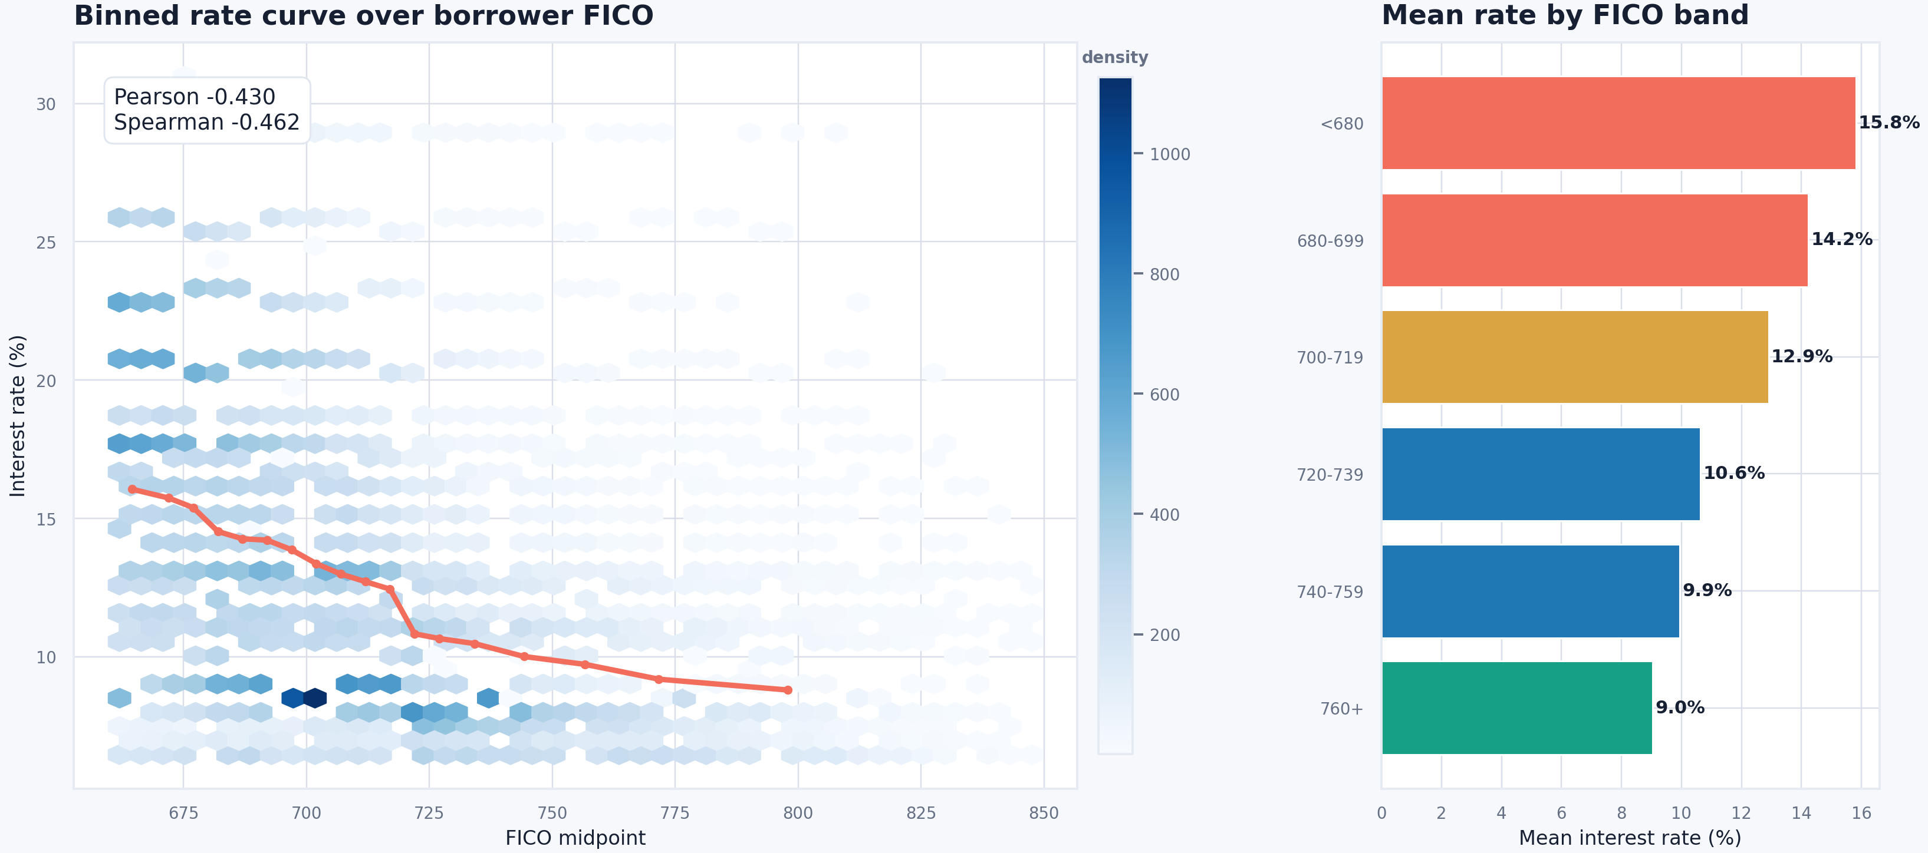
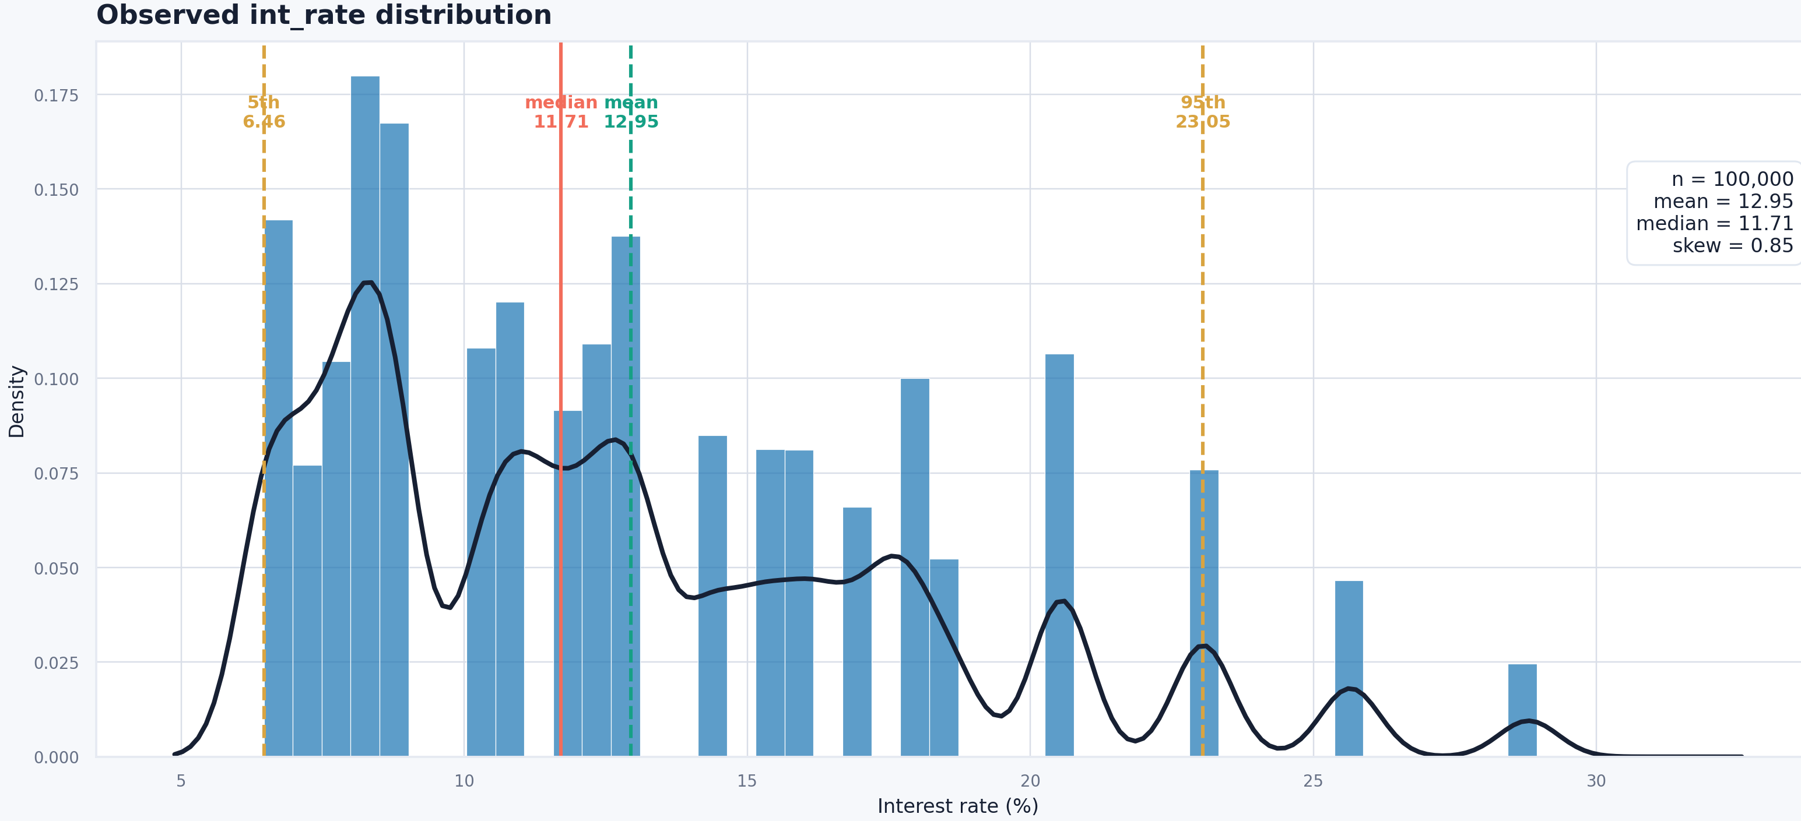
ANALYSIS · EXPLORATORY DATA ANALYSIS
What the Data Says
FICO is the dominant application-time signal; utilization, DTI and loan term carry most of the remaining recoverable variance.
KEY FINDINGS
FICO vs INTEREST RATE
FICO ↔ rate: Spearman −0.46 — higher credit score, lower APR.
Utilization next: all utilization +0.33, revolving utilization +0.30; DTI +0.18.
60-month term and small-business / educational purposes price higher.
"Months since last record" is 90.9% missing — "no record" is signal, not noise.
Test loans are smaller (loan amount PSI 0.17) and slightly higher FICO.
TARGET DISTRIBUTION
LendingClub Interest Rate Prediction · Project 1
04

Slide 7
MODELING · COMPARISON
Five Models, One Winner
We trained and tuned five model families on identical features and the same 80/20 split. CatBoost is filled below; add your other four results in the placeholder rows.
Model | CV RMSE | Val RMSE | Val MAE | Val R² | Notes
Decision Tree | — | — | — | — | [ e.g. Linear / Ridge baseline ]
Random Forest | 4.0723 | 4.019 | 3.007 | 0.410 | Good performance, slight overfitting
[ Model 3 ] | — | — | — | — | [ e.g. XGBoost ]
Neural Net (MLP) | 5.101 | — | — | 0.06 | Unstable fold; rejected
CatBoost (final) | 3.863 | 3.872 | 2.902 | 0.465 | Fold-averaged, Optuna-tuned — selected model
How to read it: lowest Val RMSE wins (ties broken by MAE). Replace the bracketed rows with your four other models — keep CatBoost as the highlighted selected model.
LendingClub Interest Rate Prediction · Project 1
05

Slide 8
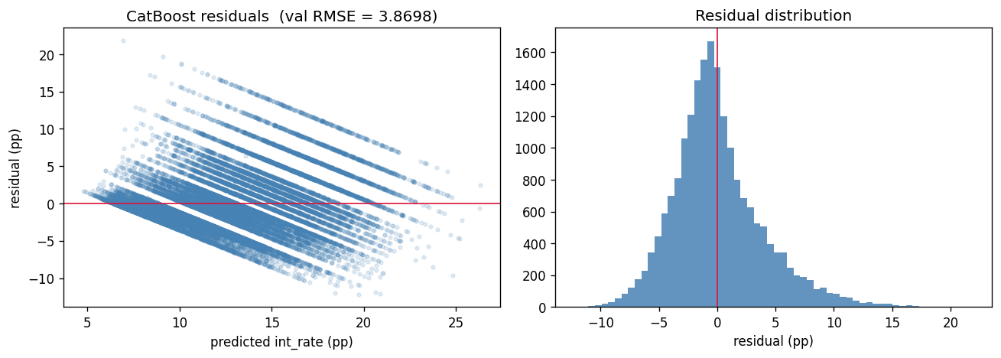
MODELING · FINAL MODEL
Final Model: CatBoost
Gradient-boosted trees with native categorical handling; 5-fold per-fold target encoding gives an honest cross-validated estimate that matches the holdout.
HELD-OUT PERFORMANCE (20%)
RESIDUAL DIAGNOSTICS
3.863
3.872
OOF RMSE (CV)
Validation RMSE
2.902
0.465
Validation MAE
Validation R²
TUNED HYPERPARAMETERS
learning_rate 0.03 · depth 7 · l2_leaf_reg 5.0
random_strength 1.0 · bagging_temperature 0.5 · border_count 200
2,500 iterations, early stopping 100; predictions clipped to [6, 31].
OOF RMSE (3.863) and holdout RMSE (3.872) agree closely — the model is well-calibrated and not over-fit. R² of 0.465 reflects the dataset's real ceiling without grade/sub-grade.
LendingClub Interest Rate Prediction · Project 1
06

Slide 9
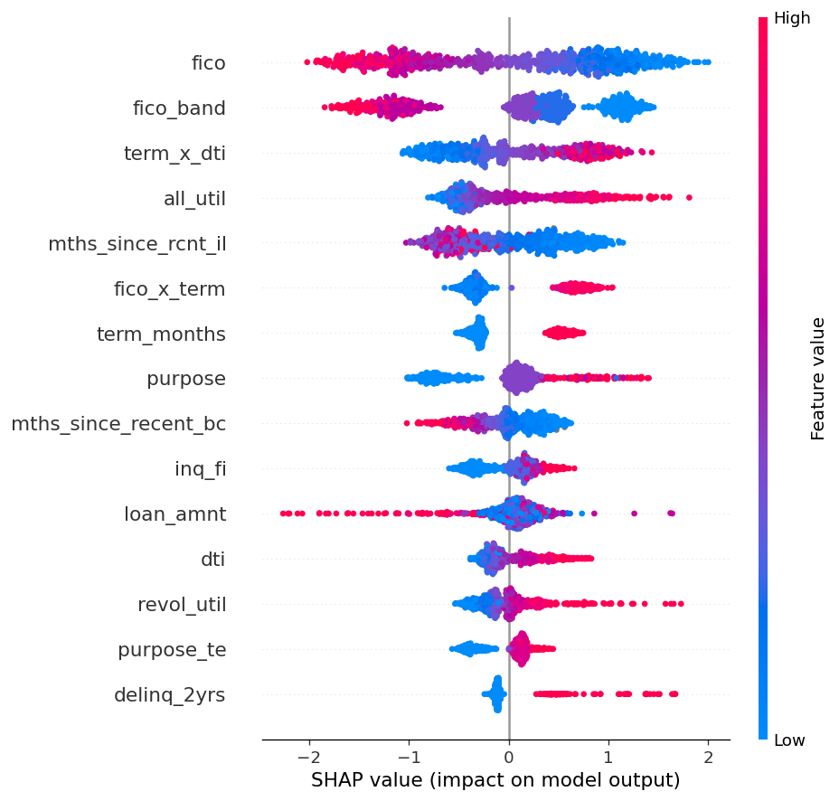
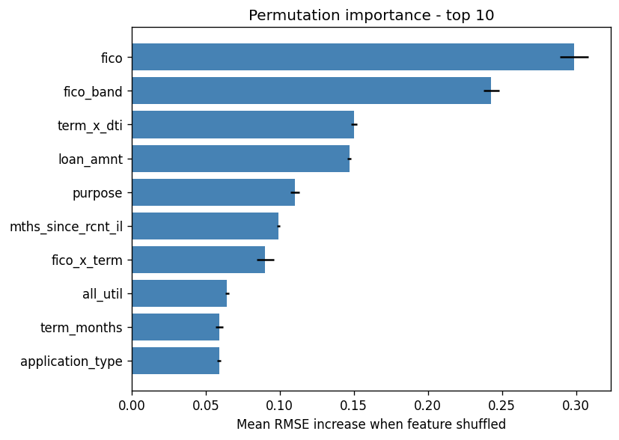
INSIGHTS · EXPLAINABILITY
Why the Model Decides
SHAP and permutation importance agree with the EDA: credit quality, loan structure, and utilization drive the rate.
SHAP SUMMARY
PERMUTATION IMPORTANCE
BUSINESS INSIGHTS
FICO dominates — a strong score is the single biggest lever on the offered rate.
Loan structure (term × DTI, loan amount) is the next driver of pricing.
Utilization and recent credit activity push rates up at the margin.
Same drivers across SHAP, permutation and gain — the model is trustworthy.
LendingClub Interest Rate Prediction · Project 1
07

Slide 10
CONCLUSION · REFLECTION
Conclusion & Reflection
WHAT WE FOUND
LESSONS LEARNED
CatBoost predicts interest rate at RMSE 3.87 / R² 0.465 on held-out data, with CV and holdout in close agreement.
FICO, loan term and utilization explain most of the recoverable signal once leakage is removed.
Disciplined leakage handling matters more than model complexity on this slice.
Audit for leakage first — dropping loan status / grade shaped the whole problem.
Fold-internal target encoding is essential to keep the CV estimate honest.
Know the ceiling: without grade/sub-grade, R² near 0.47 is the realistic limit, not a modeling failure.
Final submission: CatBoost · test RMSE-optimized · predictions clipped to [6, 31]%
LendingClub Interest Rate Prediction · Project 1
08

Slide 11
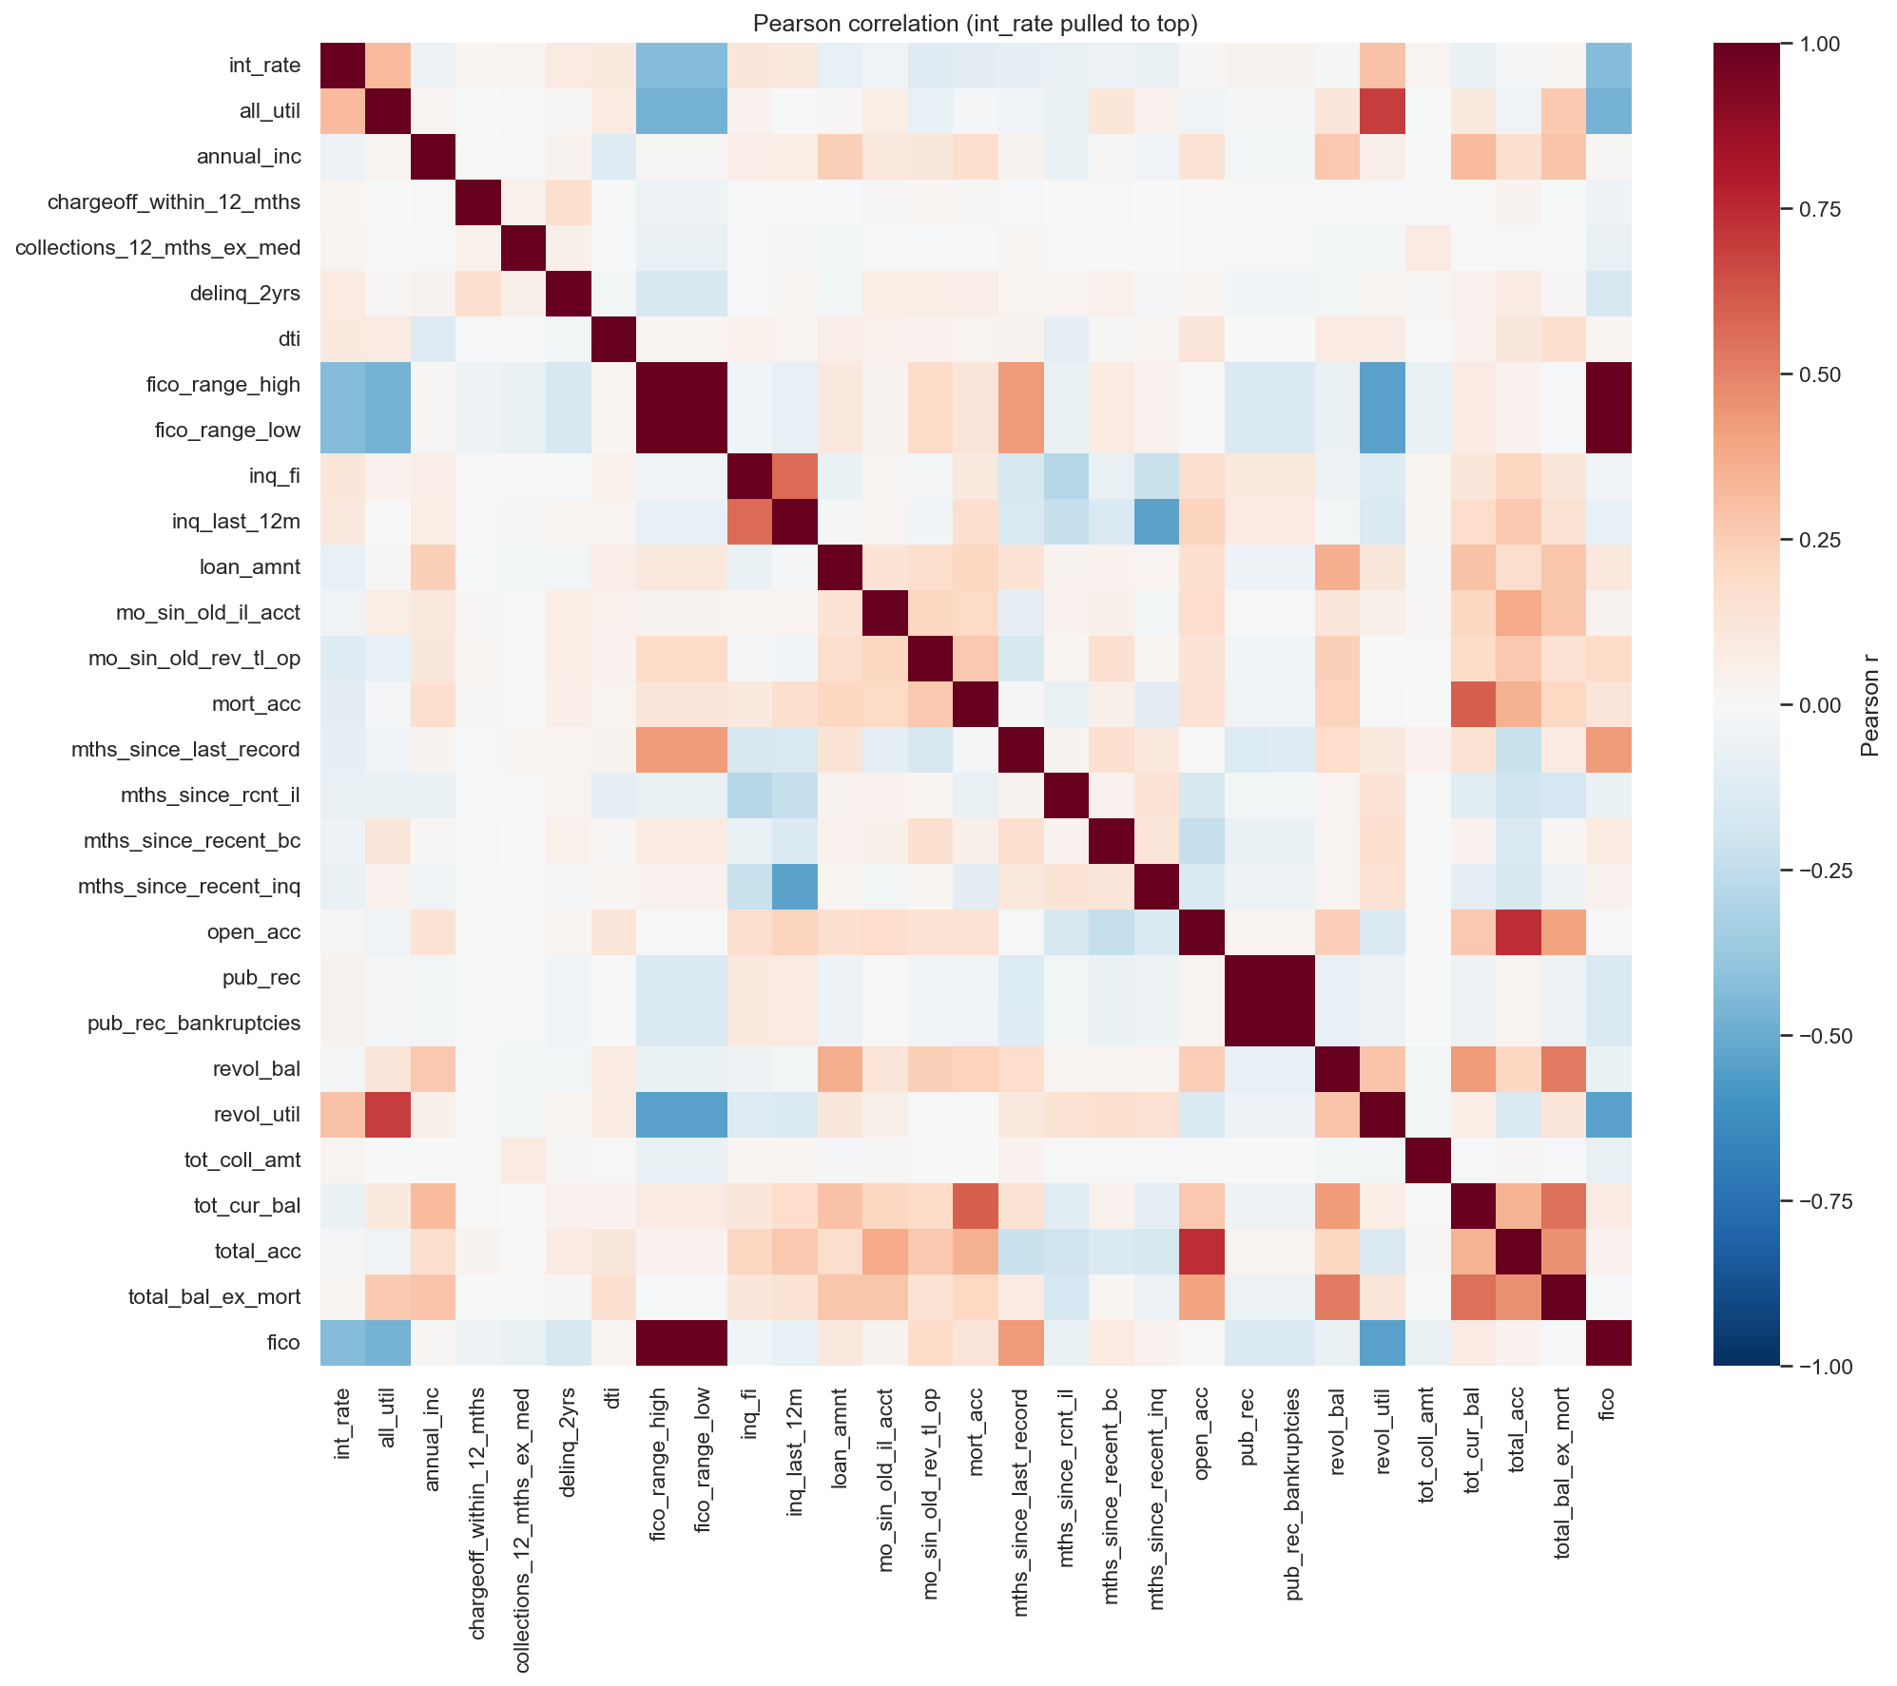
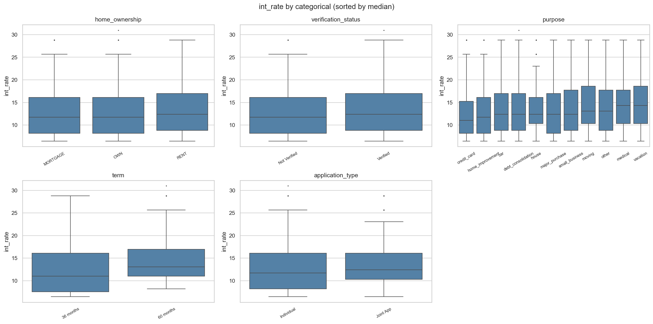
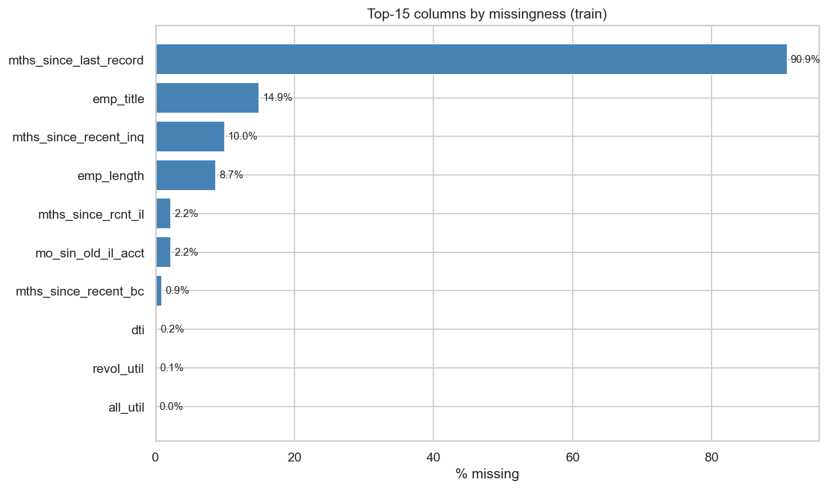
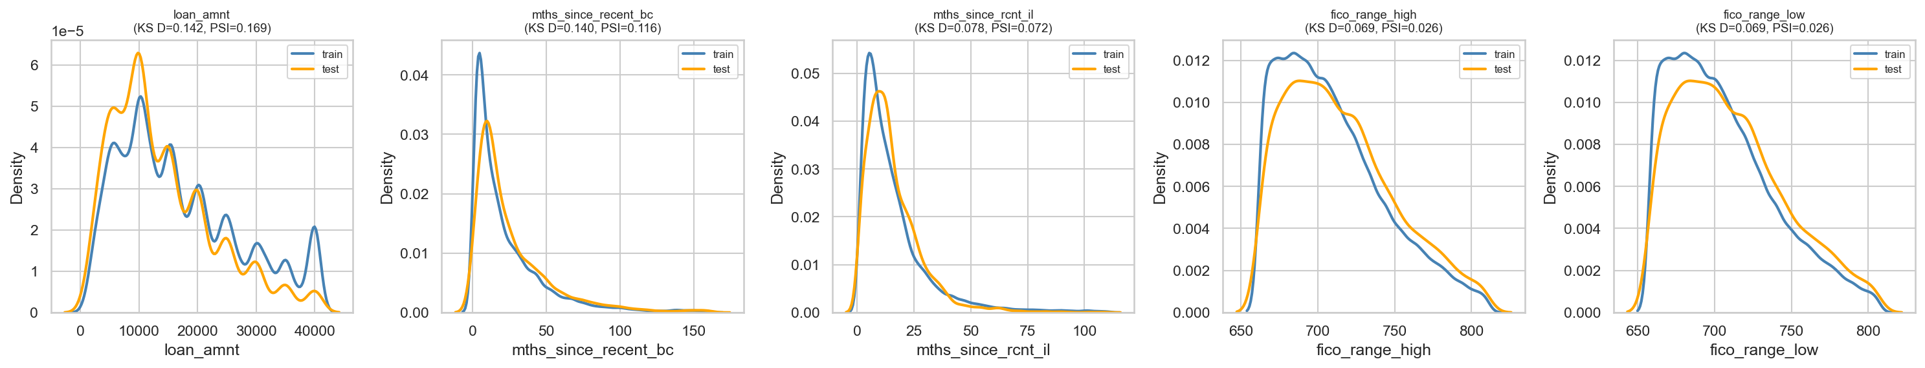
APPENDIX A
EDA Exhibits
CORRELATION STRUCTURE
RATE BY CATEGORY
MISSINGNESS (TOP COLUMNS)
TRAIN vs TEST DRIFT
LendingClub Interest Rate Prediction · Project 1
09

Slide 12
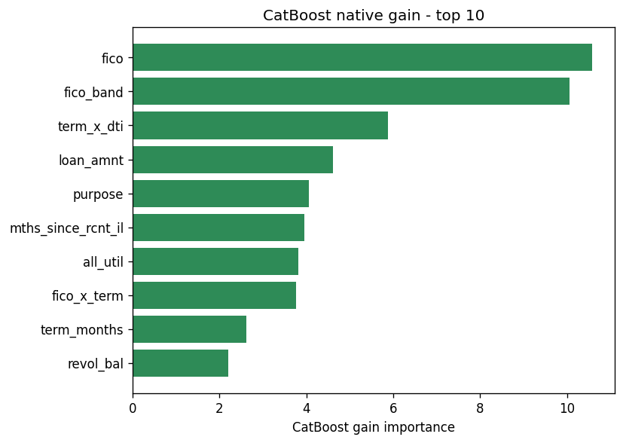
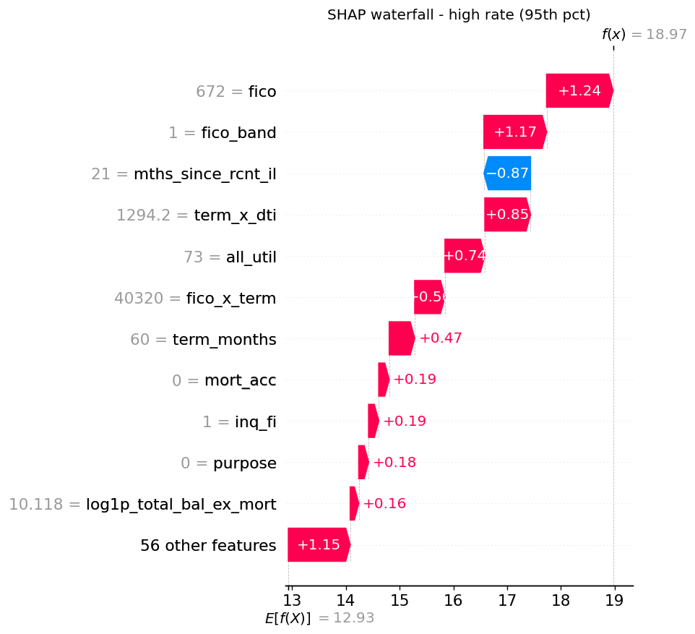
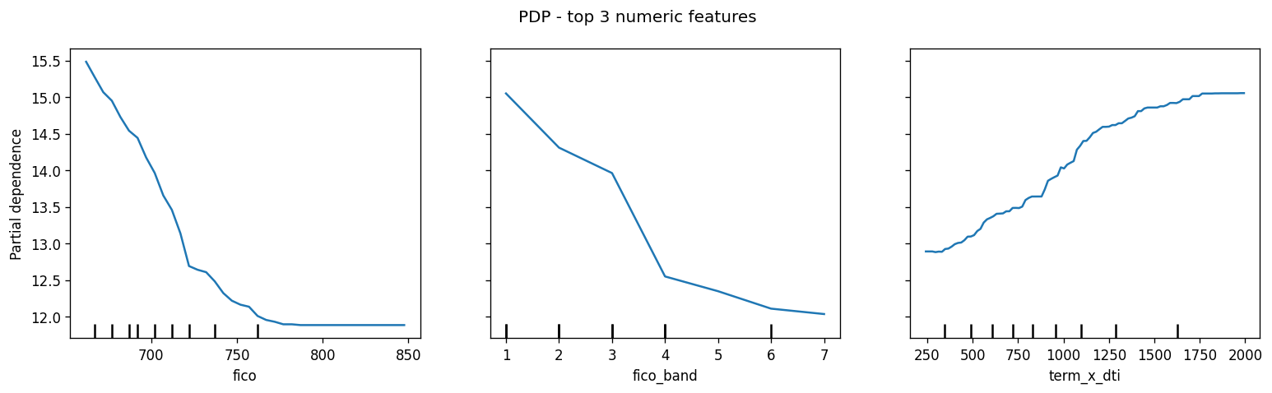
APPENDIX B
Explainability Exhibits
SHAP WATERFALL (HIGH-RATE LOAN)
CATBOOST GAIN (TOP 10)
PARTIAL DEPENDENCE (TOP 3)
LendingClub Interest Rate Prediction · Project 1
10

